Slide 1
Psychiatry Service Update – Garvey Institute Center for Neuromodulation UW Northwest Hospital – Center for Behavioral Health and Learning
Randall Espinoza, MD, mPH
Director, Center for Neuromodulation
Professor of psychiatry and behavioral sciences
UW Department of Psychiatry and Behavioral Sciences
July 2024

Slide 2
Agenda for Today
The Center for Neuromodulation
Where, who, what
Services provided (now and in the future)
Settings of care
Conditions treated
Referral process
Contact info
Intake workflow
Consultation with recommendations
Treatment process

Slide 3
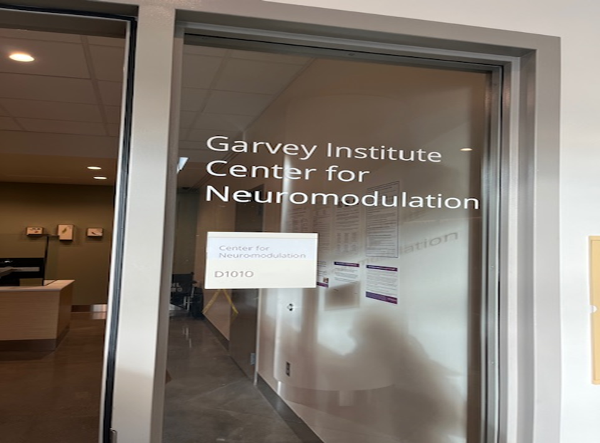
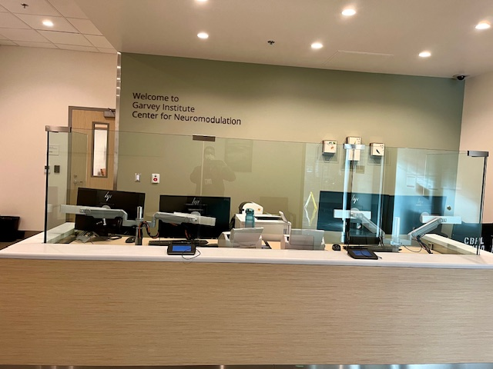
UW Northwest Hospital Center for Behavioral Health and Learning (CBHL)
1550 N 115th Street
Seattle, WA 98133

Slide 4
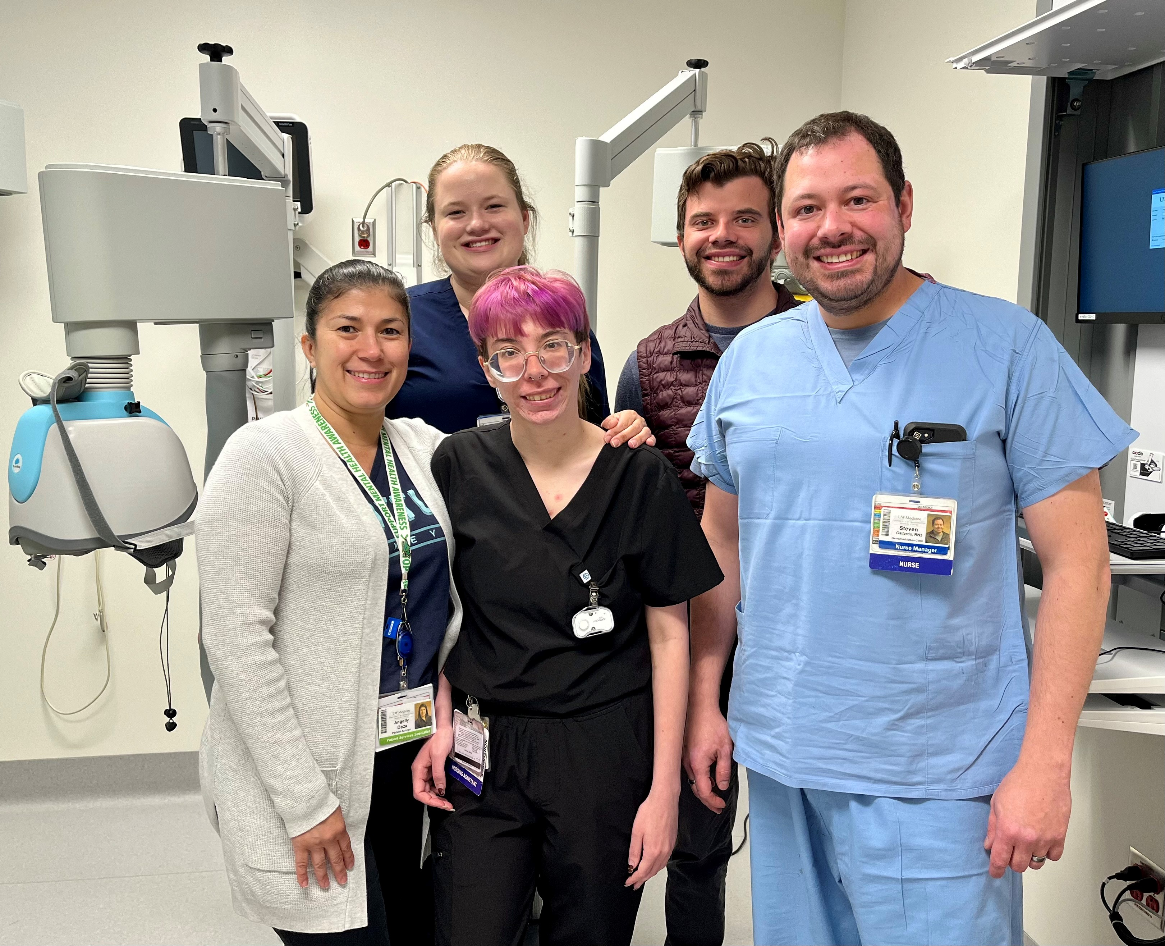
Neuromodulation Faculty
Nursing and Support Staff
Randall Espinoza, MD, MPH
Brandon Thomas, MD, PhD
Stephen Thielke, MD, MS
William Solan, MD

Slide 5
What we do
Provide state-of-the-art neuromodulation and interventional psychiatry treatments for
UW Psychiatry and UW Medicine patients
Underserved populations previously limited by access
Referrals from surrounding areas

Slide 6
Services
Settings –
Inpatients at CBHL (ITA, CC, voluntary)
Outpatients from surrounding locales
Consultation
Treatments
Electroconvulsive Therapy (ECT)
Transcranial Magnetic Stimulation (rTMS and dTMS)
(Vagus Nerve Stimulation (VNS))
(Ketamine: IV or IN)
Others in development
Collaborative care model
Services –
Consultation with recommendations
Treatments – acute and maintenance
Follow-ups while getting CfN services
Transitions and maintenance plans

Slide 7
Conditions or Disorders Considered for Treatment
 | ¹On Label | Off Label
ECT (single or adjunct) | ²MDE associated with unipolar or bipolar disorder; catatonia (irrespective of etiology) | TRD; “Double depression”; Depressive Disorder due to another medical condition; Schizophrenia; SIB associated with neuropsychiatric disorder; children < 13 years
TMS (adjunct; accelerated) dTMS | MDD, TRD, Anxious Depression, LLD (2024), OCD, Smoking Cessation | Data are very limited: PTSD and trauma, Panic Disorder, Agoraphobia, GAD, Social Anxiety Disorder, SUD, panic attacks, chronic pain, fibromyalgia, ADHD, ASD, MCI or AD
rTMS | TRD, OCD, Pain
VNS (adjunct) | ³TRD (unipolar or bipolar)
Ketamine (adjunct) IN: intranasal (esketamine) SC: subcutaneous (racemic) IV: intravenous (racemic) | ⁴TRD and MDE with acute SI/SB | TRD TRD
¹Refers to current FDA approvals, however, does not guarantee insurance coverage; ²age≥13 years who are “treatment-resistant” or require rapid response due to the severity of their psychiatric or medical condition; ³TRD includes chronic depression and failure to ≥4 antidepressant trials in current episode; ⁴TRD defined as failure of $≥$2 antidepressants in the current episode

Slide 8
Referrers –
Established and ongoing care
CfN does not provide or assume primary behavioral management
While patients can call to inquire, we do not move forward until there is confirmation of a current OP Provider
ECT: means a Psychiatrist or ARNP with Psychiatrist back-up
TMS: may not require a Psychiatrist, though may depend on acuity level
Referral Process
Website: https://www.uwmedicine.org/locations/garvey-institute-center-neuromodulation
Phone: 206-668-5320
Intake
RN staffed M-F, 8a-4:30p
Order for consult placed
Referrer provides clinical synopsis and reason for consult
Patient completes background and clinical questionnaires

Slide 9
Ongoing Provider
The clinician who retains primary behavioral care management of the patient over the course of neuromodulation therapy is the Ongoing Provider and contact. Psychiatrist involvement depends on setting of care (acuity) and neuromodulation intervention.
ECT: IP/OP – Psychiatrist
OP – PCP/ARNP with Psychiatry back-up
TMS: If on meds, then Psychiatrist, PCP, or ARNP
If not on meds, then Psychiatrist, PCP, ARNP, Psychologist, SW (and strongly consider psychotherapy)
VNS: All studies to date use VNS adjunctively, so antidepressant medications are continued during VNS therapy and usually unchanged, especially if partially beneficial. Psychiatrist involvement depends on behavioral complexity.

Slide 10
Treatment-resistant Depression: TRD
There is no universally accepted TRD definition. Consequently, insurance plans may have their own interpretation of “guidelines” impacting coverage determinations.
What is necessary is to provide as specific documentation of past trials as possible.
General: lack of response to ≥ 2 “antidepressant” trials during the current episode
Antidepressant treatment/intervention encompasses:
Antidepressant medication with or without augmentation
Psychotherapy – validated, structured forms = CBT, DBT, PHP/IOP, etc.
Neuromodulation treatments = TMS, ECT, VNS; but not tDCS, tACS, etc.
Adequate antidepressant trial
Meds
Dosage: minimum is insufficient; usually looking for maximum
Duration: need actual time period, usually lasting 4-6 weeks
May not count: unable to tolerate; AEs? Always looking for documentation.
Psychotherapy
Validated: CBT, DBT, IPT, PHP/IOP
Number of sessions
Neuromodulation courses: ECT (6-12 sessions); TMS (20-30 sessions); VNS (12 months)

Slide 11
And Thank you!

